Slide 1
Storage Systems
Morteza Nikooghadam
Chapter 12

Slide 2
Big Picture: Where are We Now?
The five classic components of a computer
Topics:
  Storage system
  BUS
Processor
Input
Control
Memory
Datapath
Output
Notes:
So where are in in the overall scheme of things.
Well, we just finished designing the processor’s datapath.
Now I am going to show you how to design the control for the datapath.
+1 = 7 min. (X:47)

Slide 3
I/O System Design Issues
Performance
Expandability
Resilience in the face of failure
Processor
interrupts
Cache
Memory - I/O Bus
Main
Memory
I/O
Controller
I/O
Controller
I/O
Controller
Disk
Disk
Graphics
Network
Notes:
This is a more in-depth picture of the I/O system of a typical computer.
The I/O devices are shown here to be connected to the computer via I/O controllers that sit on the Memory I/O busses. We will talk about buses on Friday.
For now, notice that I/O system is inherently more irregular than the Processor and the Memory system because all the different devices (disk, graphics) that can attach to it.
So when one designs an I/O system, performance is still an important consideration.
But besides raw performance, one also has to think about expandability and resilience in the face of failure.
For example, one has to ask questions such as:
(a)[Expandability]: is there any easy way to connect another disk to the system?
(b) And if this I/O controller (network) fails, is it going to affect the rest of the network?
+2 = 7 min (X:47)

Slide 4
I/O Device Examples
Device Behavior Partner Data rate(KB/sec)
Keyboard Input Human 0.01
Mouse Input Human 0.02
Line Printer Output Human 1.00
Floppy disk Storage Machine 50.00
Laser Printer Output Human 100.00
Optical Disk Storage Machine 500.00
Magnetic Disk Storage Machine 5,000.00
Network-LAN Input/Output Machine 20 – 1,000.00
Graphics Display Output Human 30,000.00
Notes:
Here are some examples of the various I/O devices you are probably familiar with.
Notice that most I/O devices that has human as their partner usually has relatively low peak data rates because human in general are slow relatively to the computer system.
The exceptions are the laser printer and the graphic displays.
Laser printer requires a high data rate because it takes a lot of bits to describe high resolution image you like to print by the laser writer.
The graphic display requires a high data rate because as I will show you later in today’s lecture, all the color objects we see in the real world and taken for granted is very hard to replicate on a graphic display.
Let’s take a closer look at one of the most popular storage device, magnetic disks.
+2 = 28 min. (Y:08)

Slide 5
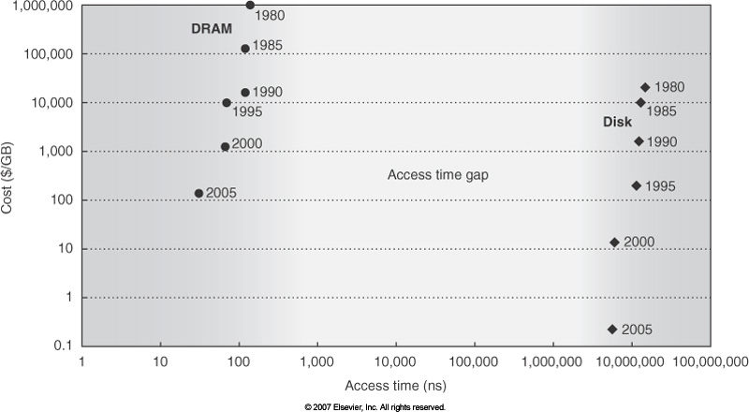
Magnetic Disks
Magnetic disks still play the central role in storage systems
  Inexpensive
  Nonvolatile: DRAM alone cannot replace disk
  Relatively fast: compared to tape, recordable CD
    But much slower than DRAM
Notes:
Cost per GB dropped 100,000x between 1983-2006
Disk Capacity Doubles Every 18 months
• Disk Positioning Rate (Seek + Rotate) Doubles Every Ten Years!

Slide 6
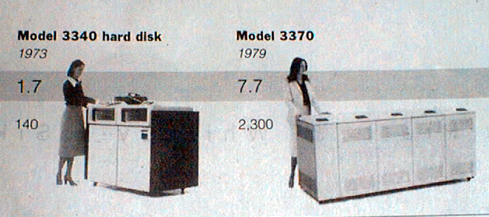
Disk History
Data
density
Mbit/sq. in.
Capacity of
Unit Shown
Megabytes
1973:
1. 7 Mbit/sq. in
140 MBytes
1979:
7. 7 Mbit/sq. in
2,300 MBytes
source: New York Times, 2/23/98, page C3,
“Makers of disk drives crowd even mroe data into even smaller spaces”

Slide 7
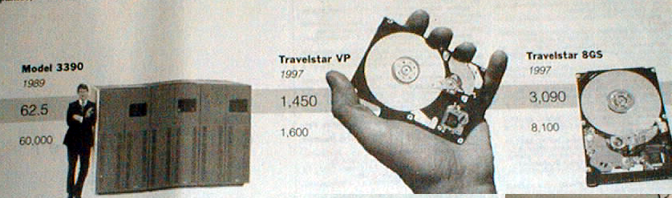
Disk History
1989:
63 Mbit/sq. in
60,000 MBytes
1997:
1450 Mbit/sq. in
2300 MBytes
1997:
3090 Mbit/sq. in
8100 MBytes
source: New York Times, 2/23/98, page C3,
“Makers of disk drives crowd even more data into even smaller spaces”

Slide 8
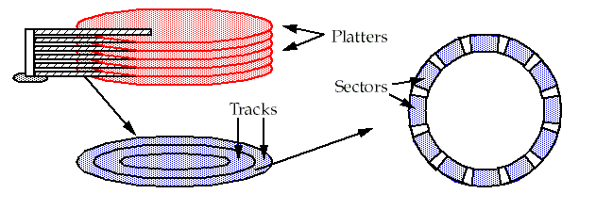
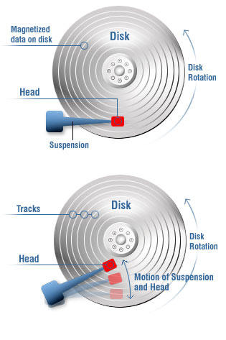
Magnetic Disks
Components
  Platter, track, sector
  Arm, head
Operations
  Read/write data is a three-stage
  process
  Seek
    Seek time: acceleration, deceleration,
    stabilization
  Wait for the right sector
    Rotational delay (0.5/RPS)
  Read/transfer
    Transfer time: f(density, speed, size)
Notes:
http://www.csee.umbc.edu/~plusquel/611/slides/chap6_1-1.gif
http://www.htch.com/images/sp_3.jpg
Here is a primitive picture showing you how a disk drive can have multiple platters.
Each surface on the platter are divided into tracks and each track is further divided into sectors. A sector is the smallest unit that can be read or written.
By simple geometry you know the outer track have more area and you would think the outer tack will have more sectors.
This, however, is not the case in traditional disk design where all tracks have the same number of sectors. Well, you will say, this is dumb but dumb is the reason they do it .
By keeping the number of sectors the same, the disk controller hardware and software can be dumb and does not have to know which track has how many sectors.
With more intelligent disk controller hardware and software, it is getting more popular to record more sectors on the outer tracks. This is referred to as constant bit density.

Slide 9
Magnetic Disk Characteristic
Average seek time as reported by the industry:
  Typically in the range of 3 ms to 14 ms
  (Sum of the time for all possible seek) / (total # of possible seeks)
  Due to locality of disk reference, actual average seek time may only be 25% to 33% of the advertised number
Rotational latency:
  Most disks rotate at 5400 to 15000 RPM
  Approximately 11 ms to 4 ms per revolution respectively
  An average latency to the desired information is halfway around the disk: 5.6 ms at 5400 RPM, 2ms at 15000 RPM
Notes:
To read write information into a sector, a movable arm containing a read/write head is located over each surface.
The term cylinder is used to refer to all the tracks under the read/write head at a given point on all surfaces.
To access data, the operating system must direct the disk through a 3-stage process.
(a) The first step is to position the arm over the proper track. This is the seek operation and
the time to complete this operation is called the seek time.
(b) Once the head has reached the correct track, we must wait for the desired sector to
rotate under the read/write head. This is referred to as the rotational latency.
(c) Finally, once the desired sector is under the read/write head, the data transfer can begin.
The average seek time as reported by the manufacturer is in the range of 12 ms to 20ms and is calculated as the sum of the time for all possible seeks divided by the number of possible seeks.
This number is usually on the pessimistic side because due to locality of disk reference, the actual average seek time may only be 25 to 33% of the number published.
+2 = 34 min. (Y:14)

Slide 10
Magnetic Disk Characteristic
Transfer time is a function of :
  Transfer size (usually a sector): 1 KB / sector
  Rotation speed: 5400 RPM to 15000 RPM
  Recording density: bits per inch on a track
  Diameter: typical diameter ranges from 2.5 to 5.25 in
  Typical transfer speed: 30 to 80 MB per second
  Cylinder: all the tracks under the head at a given point on all surface
Track
Sector
Cylinder
Platter
Head
Notes:
As far as rotational latency is concerned, most disks rotate at 3,600 RPM or approximately 16 ms per revolution.
Since on average, the information you desired is half way around the disk, the average rotational latency will be 8ms.
The transfer time is a function of transfer size, rotation speed, and recording density.
The typical transfer speed is 20 to 40 MB per second.
Notice that the transfer time is much faster than the rotational latency and seek time.
This is similar to the DRAM situation where the DRAM access time is much shorter than the DRAM cycle time.
***** Do anybody remember what we did to take advantage of the short access time versus cycle time? Well, we interleave!
+2 = 36 min. (Y:16)

Slide 11
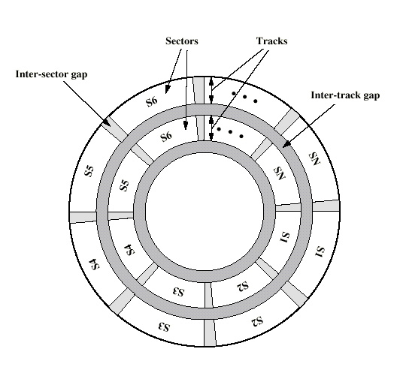
Disk Layout

Slide 12
Disk Structure
Disk drives are addressed as large 1-dimensional arrays of logical blocks, where the logical block is the smallest unit of transfer.
The 1-dimensional array of logical blocks is mapped into the sectors of the disk sequentially.
  Sector 0 is the first sector of the first track on the outermost cylinder.
  Mapping proceeds in order through that track, then the rest of the tracks in that cylinder, and then through the rest of the cylinders from outermost to innermost.

Slide 13
Scheduling and Performance
Processor and main memory speeds are several orders of magnitude faster than disk access
  Critical that we understand how disks perform
  Can scheduling make a difference?
Where are the time sinks for disk access?
  Seek time
  Rotational Delay
  Transfer Delay

Slide 14
Seek Time
This is the time to move the disk arm to the required track.
  Comprised of startup time and traversal time.
  Seek time S given by
  S = (m x n) + s
  where m is a constant, n is the number of tracks traversed and s is the startup time.
Seek times vary but are on the order of a few to about 20 ms

Slide 15
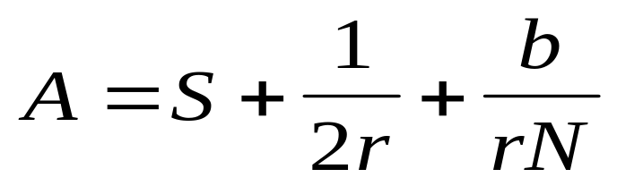
Rotational Delay and Transfer Time
Rotational delay:
  About 16.7 ms to complete one entire revolution, so average rotational delay is 8.3 ms.
Transfer delay T is given by
T = b/rN
  where b is the number of bytes to be transferred, N is the number of bytes on a track, and r is the rotation speed in revolutions per second
Total average disk access time A is given by

Slide 16
Example
512 byte sector, rotate at 5400 RPM, advertised seeks is 12 ms, transfer rate is 4 MB/sec
Basic disk access time = seek time + rotational latency + transfer time
  = 12 ms + 0.5 / 5400 RPM + 0.5 KB / 4 MB/s
  = 12 ms + 0.5 / 90 RPS + 0.125 / 1024 s
  = 12 ms + 5.5 ms + 0.1 ms
  = 17.6 ms
If real seeks are 1/3 advertised seeks, then its 9.6 ms, with rotation delay at 50% of the time!
Actual disk access time = Basic disk access time + controller overhead

Slide 17
I/O System Performance
I/O system performance depends on many aspects of the system (“limited by weakest link in the chain”):
  CPU
  Memory system:
    Internal and external caches
    Main memory
  Underlying interconnection (buses)
  I/O controller, I/O device
  The speed of the I/O software (OS)
  The efficiency of the software’s use of the I/O devices
Two common performance metrics:
  Throughput: I/O bandwidth
  Response time: latency
Notes:
Even if we look at performance alone, I/O performance is not as easy to quantify as CPU performance because I/O performance depends on many other aspect of the system.
Besides the obvious factors (the last four) such as the speed of the I/O devices and their controllers and software, the CPU, the memory system, as well as the underlying interconnect also play a major role in determining the I/O performance of a computer.
Two common I/O performance metrics are I/O throughput, also known as I/O bandwidth and I/O response time. Also known as I/O latency.
+1 = 8 min. (X:48)

Slide 18
Simple Producer-Server Model
Producer
Queue
Server
Throughput:
  The number of tasks completed by the server in unit time
  In order to get the highest possible throughput:
    The server should never be idle
    The queue should never be empty
Response time:
  Begins when a task is placed in the queue
  Ends when it is completed by the server
  In order to minimize the response time:
    The queue should be empty
    The server will be idle
Notes:
Response time and throughput are related by this producer-server model.
Throughput is the number of tasks completed by the server in unit time while response time begins when a task is placed in the queue and ends when it is completed by the server.
In order to get the highest possible throughput, the server should never be idle so the queue should never be empty.
But in order to minimize response time, you want the queue to be empty so the server is idle and can serve you as soon as place the order.
So obviously, like many other things in life, throughput and response time is a tradeoff.
+2 = 10 min. (X:50)

Slide 19
Throughput versus Respond Time
Response
Time (ms)
300
200
100
20%
40%
60%
80%
100%
Percentage of maximum throughput
Notes:
This is shown here in this response time versus percentage of maximum throughput plot.
In order to get the last few percentage of maximum throughput, you really have to pay a steep price in response time.
Notice here the horizontal scale is in percentage of maximum throughput: that is this tradeoff (curve) is in terms of relative throughput.
The absolute maximum throughput can be increased without sacrificing response time.
+1 = 11 min. (X:51)

Slide 20
Throughput Enhancement
Server
Queue
Producer
Queue
Server
In general throughput can be improved by:
  Throw more hardware at the problem
  Reduce load-related latency
Response time is much harder to reduce:
  Ultimately it is limited by the speed of light (but we’re far from it)
Notes:
For example, one way to improve the maximum throughput without sacrificing the response time is to add another server.
This bring us to an interesting fact, or joke, in I/O system and network design which says throughput is easy to improve because you can always throw more hardware at the problem.
Response time, however, is much harder to reduce, because ultimately it is limited by the speed of light and you cannot bribe God.
Even though a lot of people do try by going to church regularly.
+1 = 12 min. (X:52)

Slide 21
Disk I/O Performance
Request Rate
Service Rate
λ
μ
Disk
Controller
Disk
Queue
Processor
Disk
Controller
Disk
Queue
Disk access time = seek time + rotational latency + transfer time + controller time + queueing delay
Estimating queue length
  Queuing theory
  Related to utilization, request rate and service rate
Notes:
Utilization = U = Request Rate / Service Rate
Mean Queue Length = U / (1 - U)
As Request Rate -> Service Rate
Mean Queue Length -> Infinity
Similarly for disk access, to take advantage of the short transfer time relative to the seek and rotational delay, we can have multiple disks.
Since the transfer time is often a small fraction of a full disk access, the controller in higher performance system will disconnect the data path from the disk while it is seeking (upper) so the other disks (lower) can transfer their data to memory.
Furthermore, in order to handle a sudden burst of disk access requests gracefully, each disk can have its own queue to accept more request before the previous request is completed.
How long does the queue have to be? Well we can calculate based on queuing theory.
If the Utilization is defined as Request Rate over Service Rate, then the Mean Q Length is the utilization rate over 1 minus the utilization rate.
What happens if the utilization rate approaches one? That is when the request rate approaches the service rate? Well, the mean queue length will go to infinity.
In other words, no matter how long you make the queue, the queue will overflow and the processor needs to stall to wait for the queue to be empty before making any more request.
***** Where have we seen a similar situation before where we are putting things into the Q faster than we can empty it?
+ 3 = 39 min. (Y:19)

Slide 22
Dependability
How to decide when a system is operating properly? Service Level Agreements (SLA)
  Systems alternate between 2 states of service with respect to an SLA:
    Service accomplishment, where the service is delivered as specified in SLA (state 1)
    Service interruption, where the delivered service is different from the SLA (state 2)
  Failure = transition from state 1 to state 2
  Restoration = transition from state 2 to state 1

Slide 23
Quantify Dependability
Module reliability
  A measure of continuous service accomplishment, or equivalently, of the time to failure
  Mean Time To Failure (MTTF): reliability in hrs of operation time
  Mean Time To Repair (MTTR): service interruption
  Mean Time Between Failures (MTBF) = MTTF+MTTR
Module availability
  Module availability = MTTF / ( MTTF + MTTR)
  A measure of the service accomplishment wrt the alternation between the 2 states of accomplishment and interruption
Notes:
Module availability between 0 to 1

Slide 24
RAID
Redundant Array of Independent Disks
Applies basic design principle for speed mismatch problem
  Go to a parallel solution
6 levels (RAID 0 - 6)
Broadly defined by
  Set of physical disks viewed as a single logical disk
  Data distributed across the physical disks in an array
  Redundant disk capacity used to store parity information in case of failure (RAID 1 - 6)
80% of server installations use RAID

Slide 25
Disk Striping
In RAID 0, data are striped across a disk.
  User data is views as being stored on a logical disk divided into strips
  Stripes can be physical blocks, sectors, etc.
  Stripes mapped round robin to consecutive array members.
  First n logical strips stored as the first strip on each of the n disks, second n logical strips on each of the n disks, etc.

Slide 26
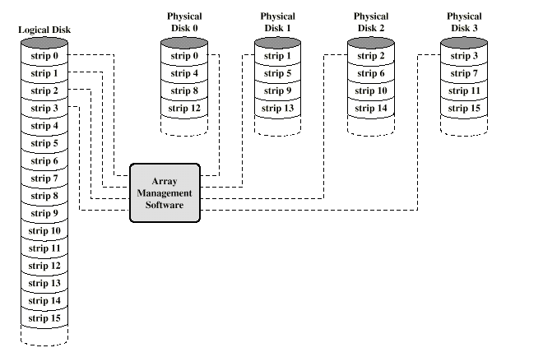
Disk Striping (2)

Slide 27
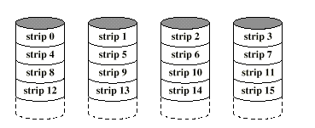
RAID 0
No redundancy
  High Data transfer requires smaller strips
  Higher IO good for multiple transaction systems

Slide 28
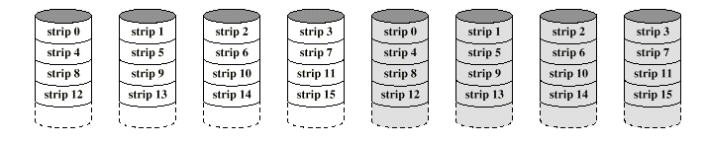
RAID 1 (mirroring)
Achieves redundancy through data duplication.
  Allows parallel updates to backups
  Simple recovery
  Great for reads, but it is expensive overall

Slide 29
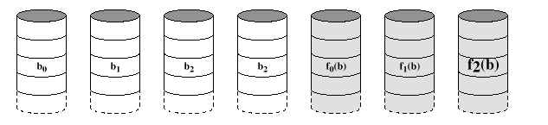
RAID 2: fallen into disuse (complex)
Parallel access, all disk members participate in the execution of every I/O request.
  Typically requires specialized hardware
  Stripes can be byte or word size.
  Adds an error correcting code, such as a Hamming code
  Number of disks proportional to the log of the number of data disks
CS465

Slide 30
RAID 3
Like RAID 2, except only has one redundant disk
  Computes a single parity bit for the set of individual bits in the same position on all disks.
  Let X4 be the parity disk, and X0 to X3 be the data disks. Then the parity for the ith bit is
  Suppose X1 fails. Then add X4(i) XOR X1(i)

Slide 31
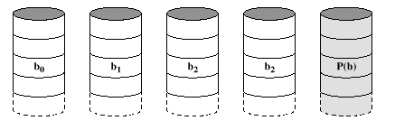
RAID 3 (2)
Small strips make high data transfer rates possible

Slide 32
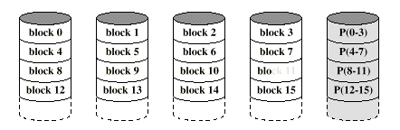
RAID 4
Each disk operates independently
  Good for high I/O request rates, not so good for high data transfer requirements
Bit-by-bit parity calculated and stored on the parity disk (like in RAID 3)
Each write involves the parity disk.

Slide 33
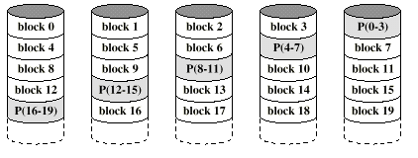
RAID 5
Like RAID 4 except the parity strip is across all disks. Avoids write bottleneck

Slide 34
RAID 6
Parity protects against single failure
It can be generalized to have a second calculation over the data and another check disk
Allows recovery from a second failure: RAID 6
Rarely used

Slide 35
Outline
Storage
  Disk performance
    Seek time, rotation latency, transfer time
  I/O performance
    Throughput, latency
    Dependability, reliability, availability
Bus ←
I/O device interfacing

Slide 36
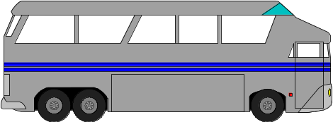
What Is a Bus?
A bus is:
  Shared communication link
  Single set of wires used to connect multiple subsystems
A bus is also a fundamental tool for composing large, complex systems
  Systematic means of abstraction
Processor
Input
Control
Memory
Datapath
Output

Slide 37
Advantages of Buses
I/O Device
I/O Device
I/O Device
Processer
Memory
Versatility:
  New devices can be added easily
  Peripherals can be moved between computer
  systems that use the same bus standard
Low cost:
  A single set of wires is shared in multiple ways
Notes:
The two major advantages of the bus organization are versatility and low cost.
By versatility, we mean new devices can easily be added.
Furthermore, if a device is designed according to a industry bus standard, it can be moved between computer systems that use the same bus standard.
The bus organization is a low cost solution because a single set of wires is shared in multiple ways.
+1 = 7 min. (X:47)

Slide 38
Disadvantage of Buses
I/O Device
I/O Device
I/O Device
Processer
Memory
It creates a communication bottleneck
  The bandwidth of that bus can limit the maximum I/O throughput
The maximum bus speed is largely limited by:
  The length of the bus
  The number of devices on the bus
  The need to support a range of devices with:
    Widely varying latencies
    Widely varying data transfer rates
Notes:
The major disadvantage of the bus organization is that it creates a communication bottleneck. When I/O must pass through a single bus, the bandwidth of that bus can limit the maximum I/O throughput.
The maximum bus speed is also largely limited by:
(a) The length of the bus.
(b) The number of I/O devices on the bus.
(C) And the need to support a wide range of devices with a widely varying latencies and
data transfer rates.
+2 = 9 min. (Y:49)

Slide 39
The General Organization of a Bus
Control Lines
Data Lines
Control lines:
  Signal requests and acknowledgments
  Indicate what type of information is on the data lines
Data lines carry information between the source and the destination:
  Data and addresses
  Complex commands
A bus transaction includes two parts:
  Issuing the command (and address) – request
  Transferring the data – action
Notes:
A bus generally contains a set of control lines and a set of data lines.
The control lines are used to signal requests and acknowledgments and to indicate what type of information is on the data lines.
The data lines carry information between the source and the destination.
This information may consists of data, addresses, or complex commands.
A bus transaction includes tow parts: (a) sending the address and (b) then receiving or sending the data.
+1 = 10 min (X:50)

Slide 40
Types of Buses
Processor-Memory Bus (design specific)
  Short and high speed
  Only need to match the memory system
    Maximize memory-to-processor bandwidth
  Optimized for cache block transfers
I/O Bus (industry standard)
  Usually lengthy and slower
  Need to match a wide range of I/O devices
  Connects to the processor-memory or backplane bus
Backplane Bus (standard or proprietary)
  Backplane: an interconnection structure within the chassis
  Allow processors, memory, and I/O devices to coexist
  Cost advantage: one bus for all components
Notes:
Buses are traditionally classified as one of 3 types: processor memory buses, I/O buses, or backplane buses. The processor memory bus is usually design specific while the I/O and backplane buses are often standard buses.
In general processor bus are short and high speed. It tries to match the memory system in order to maximize the memory-to-processor BW and is connected directly to the processor.
I/O bus usually is lengthy and slow because it has to match a wide range of I/O devices and it usually connects to the processor-memory bus or backplane bus.
Backplane bus receives its name because it was often built into the backplane of the computer--it is an interconnection structure within the chassis.
It is designed to allow processors, memory, and I/O devices to coexist on a single bus so it has the cost advantage of having only one single bus for all components.
+2 = 16 min. (X:56)

Slide 41
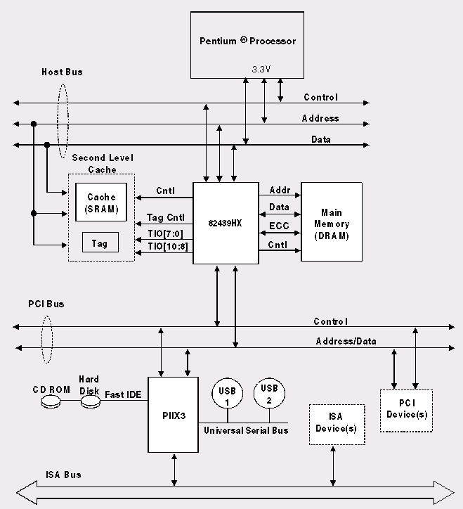
Example: Pentium Organization
Processor/Memory
Bus
PCI Bus
I/O Busses

Slide 42
Backplane Bus
Backplane Bus
Processor
Memory
I/O Devices
A single bus (the backplane bus) is used for:
  Processor to memory communication
  Communication between I/O devices and memory
Advantages: simple and low cost
Disadvantages: slow and the bus can become a major bottleneck
Example: IBM PC - AT
Notes:
Here is an example showing a single bus, the backplane bus is used to provide communication between the processor and memory.
As well as communication between I/O devices and memory.
The advantage here is of course low cost.
One disadvantage of this approach is that the bus with so many things attached to it will be lengthy and slow.
Furthermore, the bus can become a major communication bottleneck if everybody wants to use the bus at the same time.
The IBM PC is an example that uses only a backplane bus for all communication.
+2 = 18 min. (X:58)

Slide 43
A Two-Bus System
Processor Memory Bus
Processor
Memory
Bus
Adaptor
Bus
Adaptor
Bus
Adaptor
I/O
Bus
I/O
Bus
I/O
Bus
I/O buses tap into the processor-memory bus via bus adaptors:
  Processor-memory bus: mainly for processor-memory traffic
  I/O buses: provide expansion slots for I/O devices
Apple Macintosh-II
  NuBus: processor, memory, and a few selected I/O devices
  SCCI Bus: the rest of the I/O devices
Notes:
Here is an example using two buses where multiple I/O buses tap into the processor-memory bus via bus adaptors.
The Processor-memory bus is used mainly for processor-memory traffic while the I/O buses are used to provide expansion slots for the I/O devices.
The Apple Macintosh-II adopts this organization where the NuBus is used to connect processor, memory, and a few selected I/O devices together.
The rest of the I/O devices reside on an industry standard bus, the SCCI Bus, which is connected to the NuBus via a bus adaptor.
+2 = 25 min. (Y:05)

Slide 44
A Three-Bus System
Processor Memory Bus
Processor
Memory
Bus
Adaptor
Backside
Cache bus
Bus
Adaptor
I/O Bus
L2 Cache
Bus
Adaptor
I/O Bus
A small number of backplane buses tap into the processor-memory bus
  Processor-memory bus is only used for processor-memory traffic
  I/O buses are connected to the backplane bus
Advantage: loading on the processor bus is greatly reduced
Notes:
Finally, in a 3-bus system, a small number of backplane buses (in our example here, just 1) tap into the processor-memory bus.
The processor-memory bus is used mainly for processor memory traffic while the I/O buses are connected to the backplane bus via bus adaptors.
An advantage of this organization is that the loading on the processor-memory bus is greatly reduced because of the small number of taps into the high-speed processor-memory bus.
+1 = 26 min. (Y:06)

Slide 45
Synchronous/Asynchronous Bus
Synchronous Bus:
  Includes a clock in the control lines
  A fixed communication protocol relative to the clock
  Advantage: involves very little logic; can run very fast
  Disadvantages:
    Every device on the bus must run at the same clock rate
    To avoid clock skew, bus cannot be long if they are fast
Asynchronous Bus:
  It is not clocked
  It can accommodate a wide range of devices
  It can be lengthened w/o worrying about clock skew
  It requires a handshaking protocol
    Needs additional set of control lines
Notes:
There are substantial differences between the design requirements for the I/O buses and processor-memory buses and the backplane buses.
Consequently, there are two different schemes for communication on the bus: synchronous and asynchronous.
Synchronous bus includes a clock in the control lines and a fixed protocol for communication that is relative to the clock.
Since the protocol is fixed and everything happens with respect to the clock, it involves very logic and can run very fast. Most processor-memory buses fall into this category.
Synchronous buses have two major disadvantages: (1) every device on the bus must run at the same clock rate. (2) And if they are fast, they must be short to avoid clock skew problem.
By definition, an asynchronous bus is not clocked so it can accommodate a wide range of devices at different clock rates and can be lengthened without worrying about clock skew.
The draw back is that it can be slow and more complex because a handshaking protocol is needed to coordinate the transmission of data between the sender and receiver.
+2 = 28 min. (Y:08)

Slide 46
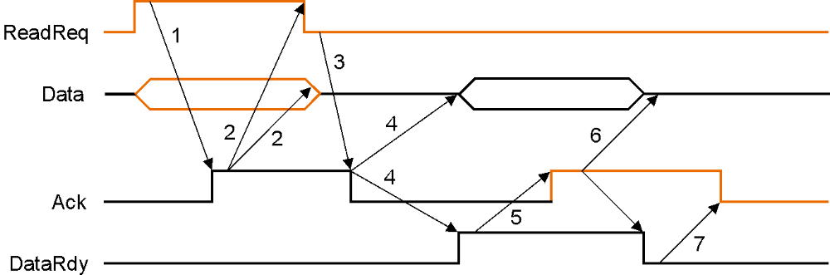
Asynchronous Handshaking Protocol
Figure 8.10: 7 steps to read a word from memory
and receive it in an I/O device
4. This starts when the memory has the data ready. It places the data from the read request on the data lines and raises DataRdy
3. Memory sees that ReadReq is low and drops the Ack line to acknowledge the Read Req signal
5. The I/O sees DataRdy, reads the data from the bus, and signals that it ahs the data by raising Ack.
6. The memory sees the Ack signal, drops DataRdy, and releases the data lines.
7. Finally, the I/O devices, seeing DataRdy go low, drops the Ack line, which indicates that the transmission is completed.
When memory sees the ReadReq line, it reads the address from the data bus
and raises Ack to indicate it has been seen.
2. I/O device sees the Ack line high and releases the ReadReq and data lines.

Slide 47
Outline
Storage
Bus
  Important technique for building large-scale systems
    Different types of buses
  Two types of bus timing:
    Synchronous: bus includes clock
    Asynchronous: no clock, just REQ/ACK
I/O device interfacing ←

Slide 48
Responsibilities of OS
The operating system acts as the interface between:
  The I/O hardware and the program that requests I/O
Three characteristics of the I/O systems:
  The I/O system is shared by multiple programs using the processor
  I/O systems often use interrupts (external generated exceptions) to communicate information about I/O operations.
    Interrupts must be handled by the OS because they cause a transfer to supervisor mode
  The low-level control of an I/O device is complex:
    Managing a set of concurrent events
    The requirements for correct device control are very detailed
Notes:
The OS acts as the interface between the I/O hardware and the program that requests I/O.
The responsibilities of the operating system arise from 3 characteristics of the I/O systems:
(a) First the I/O system is shared by multiple programs using the processor.
(b) I/O system, as I will show you, often use interrupts to communicate information
about I/O operation and interrupt must be handled by the OS.
(c) Finally, the low-level control of an I/O device is very complex so we should leave
to those crazy kernel programers to handle them.
+1 = 52 min. (Y:32)

Slide 49
Required Functions of OS
Provide protection to shared I/O resources
  Guarantee that a user’s program can only access the
  portions of an I/O device to which the user has rights
Provides abstraction for accessing devices:
  Supply routines that handle low-level device operation
Handles the interrupts generated by I/O devices
Provide equitable access to the shared I/O resources
  All user programs must have equal access to the I/O resources
Schedule accesses in order to enhance system throughput
Notes:
Here is a list of the function the OS must provide. First it must guarantee that a user’s program can only access the portion of an I/O device that it has the right to do so.
Then the OS must hide low level complexity from the user by suppling routines that handle low-level device operation.
The OS also needs to handle the interrupts generated by I/O devices.
And the OS must be be fair: all user programs must have equal access to the I/O resources.
Finally, the OS needs to schedule accesses in a way that system throughput is enhanced.
+1 = 53 min. (Y:33)

Slide 50
Communication Requirements
The operating system must be able to prevent:
  The user program from communicating with the I/O device directly
If user programs could perform I/O directly:
  Protection to the shared I/O resources could not be provided
Three types of communication are required:
  The OS must be able to give commands to the I/O devices
  The I/O device must be able to notify the OS when the I/O device has completed an operation or has encountered an error
  Data must be transferred between memory and an I/O device
Notes:
The OS must be able to communicate with the I/O system but at the same time, the OS must be able to prevent the user from communicating with the I/O device directly.
Why? Because if user programs could perform I/O directly, we would not be able to provide protection to the shared I/O device.
Three types of communications are required:
(1) First the OS must be able to give commands to the I/O devices.
(2) Secondly, the device e must be able to notify the OS when the I/O device has completed
an operation or has encountered an error.
(3) Data must be transferred between memory and an I/O device.
+2 = 55 min. (Y:35)

Slide 51
Giving Commands to I/O Devices
Special I/O instructions specify:
  Both the device number and the command word
    Device number: the processor communicates this via a
    set of wires normally included as part of the I/O bus
    Command word: this is usually sent on the bus’s data lines
Memory-mapped I/O:
  Portions of the address space are assigned to I/O device
  Read and write to those addresses are interpreted
  as commands to the I/O devices
  User programs are prevented from issuing I/O operations directly:
    The I/O address space is protected by the address translation
    Why it is popular?
Notes:
How do the OS give commands to the I/O device? There are two methods. Special I/O instructions and memory-mapped I/O.
If special I/O instructions are used, the OS will use the I/O instruction to specify both the device number and the command word.
The processor then executes the special I/O instruction by passing the device number to the I/O device (in most cases) via a set of control lines on the bus and at the same time sends the command to the I/O device using the bus’s data lines.
Special I/O instructions are not used that widely. Most processors use memory-mapped I/O where portions of the address space are assigned to the I/O device.
Read and write to this special address space are interpreted by the memory controller as I/O commands and the memory controller will do right thing to communicate with the I/O device
Why is memory-mapeed I/O so popular? Well, it is popular because we can use the same protection mechanism we already implemented for virtual memory to prevent the user from issuing commands to the I/O device directly.
+2 = 57 min. (Y:37)

Slide 52
I/O Device Notifying the OS
The OS needs to know when:
  The I/O device has completed an operation
  The I/O operation has encountered an error
This can be accomplished in two different ways
  I/O Interrupt:
    Whenever an I/O device needs attention from the processor,
    it interrupts the processor from what it is currently doing
  Polling:
    The I/O device put information in a status register
    The OS periodically check the status register
Notes:
After the OS has issued a command to the I/O device either via a special I/O instruction or by writing to a location in the I/O address space, the OS needs to be notified when:
(a) The I/O device has completed the operation.
(b) Or when the I/O device has encountered an error.
This can be accomplished in two different ways: Polling and I/O interrupt.
+1 = 58 min. (Y:38)

Slide 53
I/O Interrupt
An I/O interrupt is just like the exceptions except:
  An I/O interrupt is asynchronous
  Further information needs to be conveyed
An I/O interrupt is asynchronous with respect to instruction execution:
  I/O interrupt is not associated with any instruction
  I/O interrupt does not prevent any instruction from completion
    You can pick your own convenient point to take an interrupt
I/O interrupt is more complicated than exception:
  Needs to convey the identity of the device generating the interrupt
  Interrupt requests can have different urgencies:
    Interrupt request needs to be prioritized
Notes:
How does an I/O interrupt different from the exception you already learned?
Well, an I/O interrupt is asynchronous with respect to the instruction execution while exception such as overflow or page fault are always associated with a certain instruction.
Also for exception, the only information needs to be conveyed is the fact that an exceptional condition has occurred but for interrupt, there is more information to be conveyed.
Let me elaborate on each of these two points.
Unlike exception, which is always associated with an instruction, interrupt is not associated with any instruction. The user program is just doing its things when an I/O interrupt occurs.
So I/O interrupt does not prevent any instruction from completing so you can pick your own convenient point to take the interrupt.
As far as conveying more information is concerned, the interrupt detection hardware must somehow let the OS know who is causing the interrupt.
Furthermore, interrupt requests needs to be prioritized. The hardware that can do all these looks like this.
+2 = 64 min. (Y:44)

Slide 54
Polling: Programmed I/O
CPU
Is the
data
ready?
busy wait loop
not an efficient
way to use the CPU
unless the device
is very fast!
yes
no
Memory
read
data
IOC
but checks for I/O
completion can be
dispersed among
computation
intensive code
device
store
data
done?
no
Advantage:
  Simple: the processor is totally in control and does all the work
Disadvantage:
  Polling overhead can consume a lot of CPU time
yes
Notes:
In Polling, the I/O device put information in a status register and the OS periodically check it (the busy loop) to see if the data is ready or if an error condition has occurred.
If the data is ready, fine: read the data and move on. If not, we stay in this loop and try again at a later time.
The advantage of this approach is simple: the processor is totally in control and does all the work but the processor in total control is also the problem.
Needless to say, polling overhead can consume a lot of CPU time if the device is very fast.
For this reason (Disadvantage), most I/O devices notify the processor via I/O interrupt.
+2 = 60 min. (Y:40)

Slide 55
Interrupt-Driven Input
1. input interrupt
Processor
add
sub
and
or
beq
user
program
Memory
Receiver
Keyboard
lbu
sb
...
jr
input
interrupt
service
routine
:
memory
Notes:
For class handout

Slide 56
Interrupt-Driven Input
1. input interrupt
Processor
add
sub
and
or
beq
user
program
2.1 save state
Memory
Receiver
2.3 service interrupt
2.2 jump to interrupt
service routine
Keyboard
lbu
sb
...
jr
input
interrupt
service
routine
2.4 return
to user code
memory
Notes:
That is, whenever an I/O device needs attention from the processor, it interrupts the processor from what it is currently doing.
This is how an I/O interrupt looks in the overall scheme of things. The processor is minding its business when one of the I/O device wants its attention and causes an I/O interrupt.
The processor then save the current PC, branch to the address where the interrupt service routine resides, and start executing the interrupt service routine.
When it finishes executing the interrupt service routine, it branches back to the point of the original program where we stop and continue.
The advantage of this approach is efficiency. The user program’s progress is halted only during actual transfer.
The disadvantage is that it require special hardware in the I/O device to generate the interrupt. And on the processor side, we need special hardware to detect the interrupt and then to save the proper states so we can resume after the interrupt.
+2 = 62 min. (Y:42)

Slide 57
Interrupt-Driven Output
1.output interrupt
Processor
add
sub
and
or
beq
user
program
2.1 save state
Memory
Trnsmttr
2.3 service interrupt
2.2 jump to interrupt
service routine
Display
lbu
sb
...
jr
output
interrupt
service
routine
2.4 return
to user code
memory

Slide 58
Direct Memory Access
Polling and I/O interrupts work best with lower-bandwidth devices
Typical I/O devices must transfer large amounts of data to memory or processor:
  Disk must transfer complete block (4K? 16K?)
  Large packets from network
  Regions of frame buffer
An alternative mechanism for having the device controller transfer data directly to/from memory w/o involving the processor: direct memory access (DMA)
  Processor (or at least memory system) acts like slave

Slide 59
DMA
CPU sends a starting address,
direction, and length count
to DMAC. Then issues "start"
Direct Memory Access:
  DMA controller act as a master on the bus
  Transfer blocks of data to or from memory without CPU intervention
Issue: cache coherence
  What if I/O devices write data that is currently in processor cache?
    The processor may never see new data!
    Flush cache on every I/O operation (expensive)
    Have hardware invalidate cache lines
CPU
Memory
DMAC
IOC
device
DMAC provides handshake
signals for Peripheral
Controller, and Memory
Addresses and handshake
signals for Memory
Notes:
Delegating I/O responsibility from CPU
Finally, lets see how we can delegate some of the I/O responsibilities from the CPU.
The first option is Direct Memory Access which take advantage of the fact that I/O events often involve block transfer: you are not going to access the disk 1 byte at a time.
The DMA controller is external to the processor and can acts as a bus master to transfer blocks of data to or from memory and the I/O device without CPU intervention.
This is how it works. The CPU sends the starting address, the direction and length of the transfer to the DMA controller and issues a start command.
The DMA controller then take over from there and provides handshake signals required (point to the last text block) to complete the entire block transfer.
So the DMA controller are pretty intelligent. If you add more intelligent to the DMA controller, you will end up with a IO processor or IOP for short.
+2 = 72 min. (Y:52)

Slide 60
Summary
Disk
  Access time: seek time, rotation latency, transfer time
Buses
  An important technique for building large-scale systems
  Different types of buses
  Different types of timing
Interfacing I/O devices to memory, processor,and OS
  I/O interrupts, polling
  DMA(Direct Memory Access) allows fast, bursty transfer into processor’s memory

